Slide 1
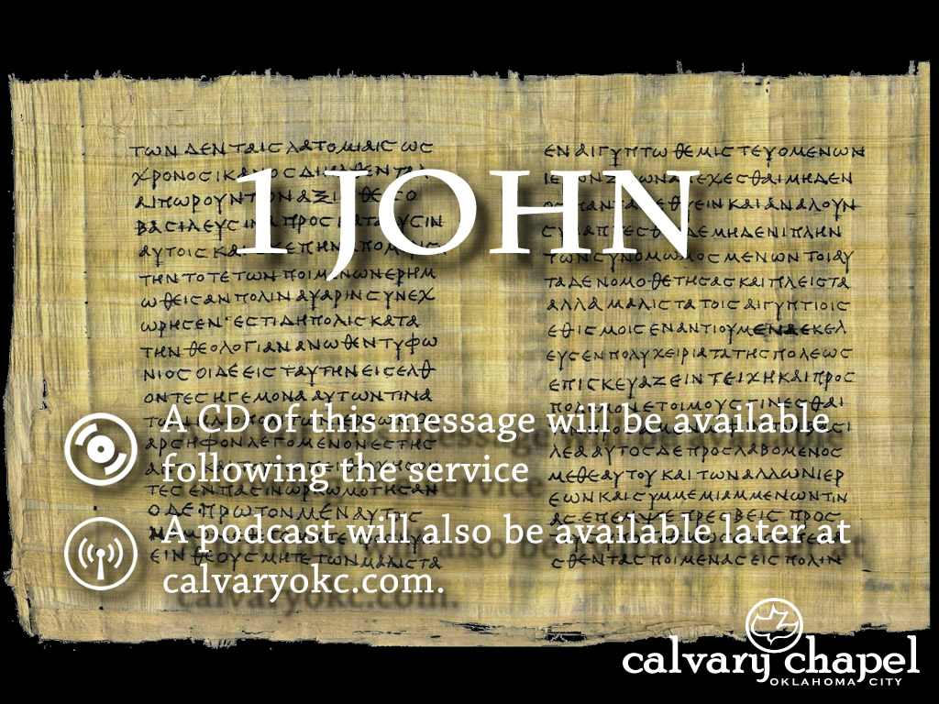
5:14-21

Slide 2
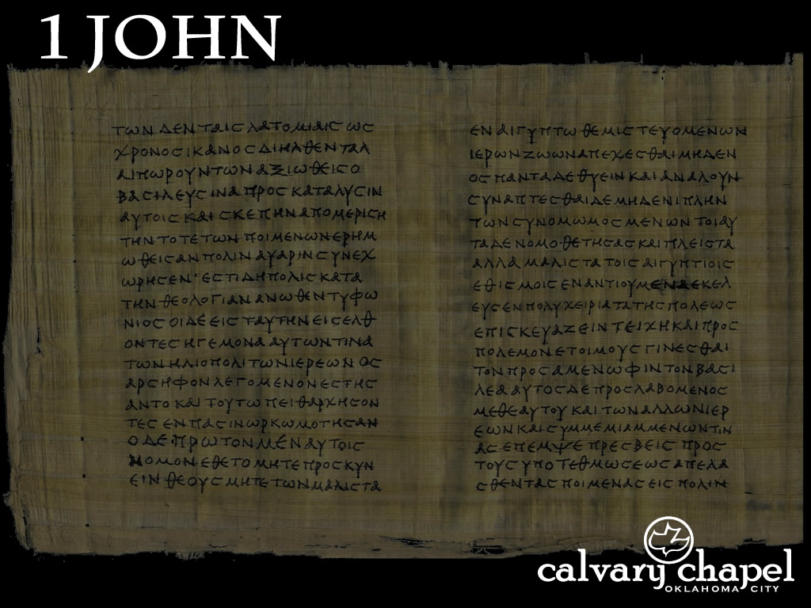
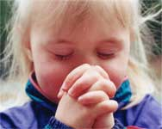
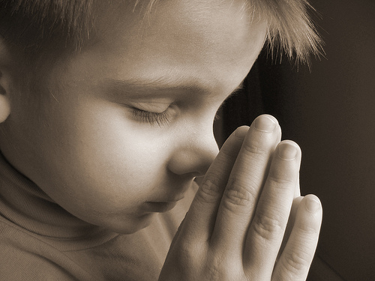
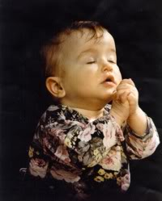

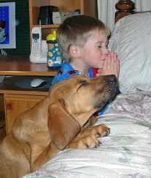
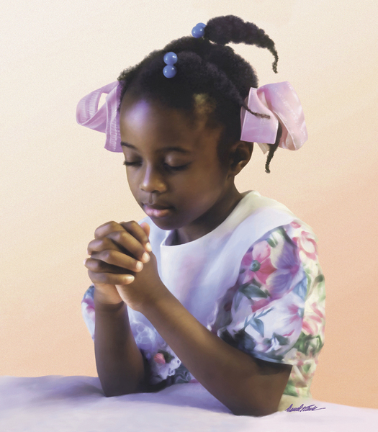
5:14-21

Slide 3
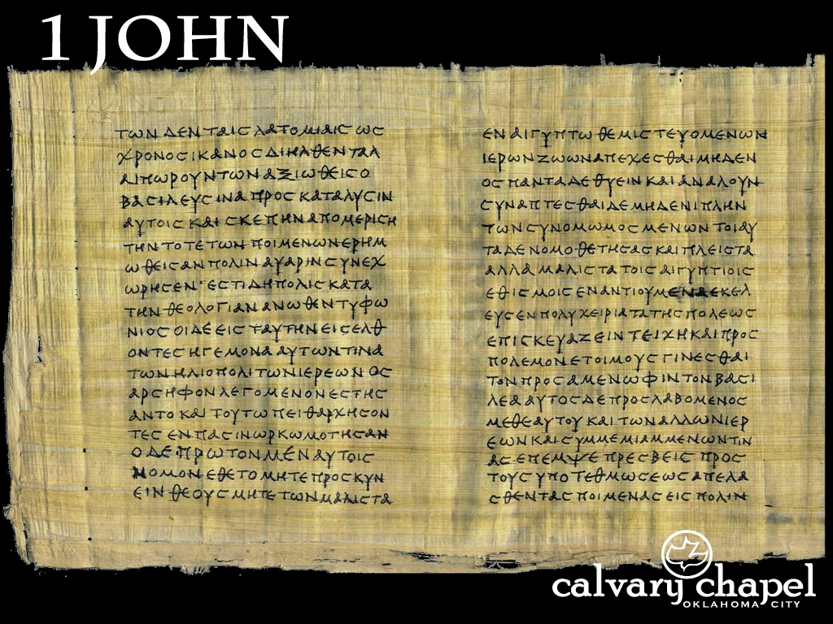
5:14-21

Slide 4
5:14-21
Jam. 4:3 ~ You ask and do not receive, because you ask amiss, that you may spend it on your pleasures.
Pleasures ~ hēdonē – hedonism
Confidence ~ parrēsia – freedom in speaking; unreservedness in speech; openly, frankly, without ambiguity or circumlocution

Slide 5
5:14-21

Slide 6
5:14-21
If anyone sees his brother sinning a sin which does not lead to death, he will ask, and He will give him life for those who commit sin not leading to death. There is sin leading to death. I do not say that he should pray about that.
1 Cor. 5:5 ~ … deliver such a one to Satan for the destruction of the flesh, that his spirit may be saved in the day of the Lord Jesus.

Slide 7
5:14-21
Heinous sin
Venial vs. mortal (Roman Catholic Church)
RSV ~ If any one sees his brother committing what is not a mortal sin, he will ask, and God will give him life for those whose sin is not mortal.
Spiritual death
Unforgivable sin (Matt. 12:22-37)

Slide 8
5:14-21
Physical death
Destructive behavior
Substance abuse
Careless lifestyle, etc.
Divine judgment
Many Old Testament examples
Ananias and Sapphira (Acts 5:1-11)
Approaching the Lord’s Table in an unworthy manner (1 Cor. 11:28-30)

Slide 9
5:14-21

Slide 10
5:14-21
¹⁸ We know that no one who is born of God sins; but He who was born of God keeps him, and the evil one does not touch him. ¹⁹ We know that we are of God, and that the whole world lies in the power of the evil one. ²⁰ And we know that the Son of God has come, and has given us understanding so that we may know Him who is true; and we are in Him who is true, in His Son Jesus Christ.
oida ~ to know intuitively
ginōskō ~ to know by experience

Slide 11
5:14-21

Slide 12
5:14-21
Wicked one ~ two words for “wicked/evil”
kakos ~ “evil in the abstract” (Wuest) – one who is content to perish in his own corruption
ponēros ~ “evil in active opposition to the good” (Wuest) – one who seeks to drag everyone down with him

Slide 13
5:14-21
Keeps himself ~ better, him
Merrihew Standard Version ~ We know that when a person has been once and for all born again, he doesn’t continue in the sinful choices as before – and Jesus, God’s only begotten Son, will continue keeping de debil from continually touching him.

Slide 14
5:14-21

Slide 15
5:14-21
Ray Stedman ~ “‘Well,’ someone says, ‘what smug presumption. Imagine! That's the trouble with you Christians. You think you're so much better than everybody else. You think you're so superior!’
“No, not superior; just separated! Not better; just blessed – with a blessing that is open to anyone who wants to receive it. This is what makes Christians talk this way.”

Slide 16
5:14-21

Slide 17
5:14-21
True ~ alēthinos – genuine, real

Slide 18
5:14-21

Slide 19
5:14-21
Col. 3:5 ~ Therefore put to death your members which are on the earth: fornication, uncleanness, passion, evil desire, and covetousness, which is idolatry.

Slide 20
5:14-21

